Slide 1
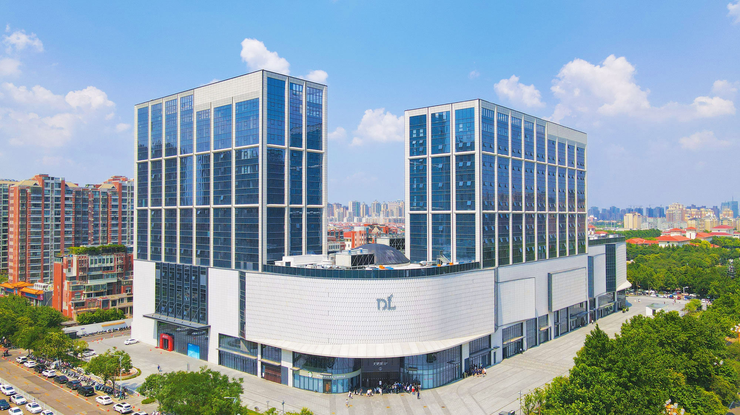
PDL Handle a PR Crisis
Group numbers：Jocelyn, Rin, Cecilia, Judy

Slide 2


Xuchang PDL Trading Group Co., Ltd. is a comprehensive retail enterprise,
founded in March 1995, headquartered in Xuchang City, Henan Province

Slide 3
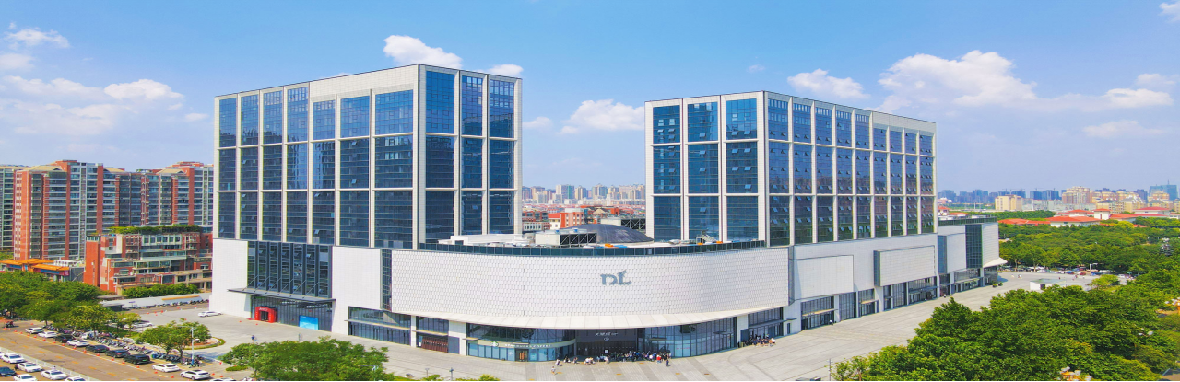
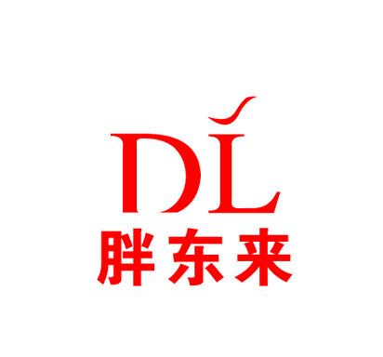
CONTENT
01. Crisis Example & Explain the Crisis
02. Steps Taken by the Company
03. Role of Public Relations
04. Outcome

Slide 4
PART 1
Crisis Example &Explain the Crisis
The cause of the crisis
On June 25, 2024, a netizen posted a video reflecting that there were production environment problems in a noodle shop in the catering department of PDL.
Possible impact of the crisis
The crisis has attracted wide attention on social media and has been reported by major media outlets：
1. The risk of a collapse in consumer trust
2. Regulatory and legal risks escalate
3. Comprehensive questioning of the internal management system

Slide 5
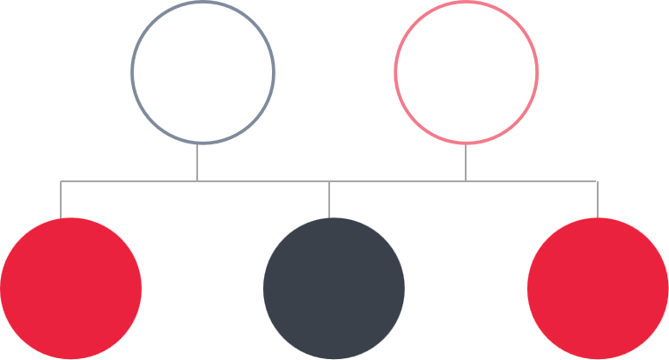
PART 2
Steps Taken by the Company
Arranged for relevant personnel to conduct investigations
2024.
06.20
2024.
06.26
Focused on social media
2024.
06.19
2024.
06.23
2024.
06.27
Issued the investigation report, carryd out after-sales service and took relevant measures
Received a
Complaint
Resumed operations

Slide 6
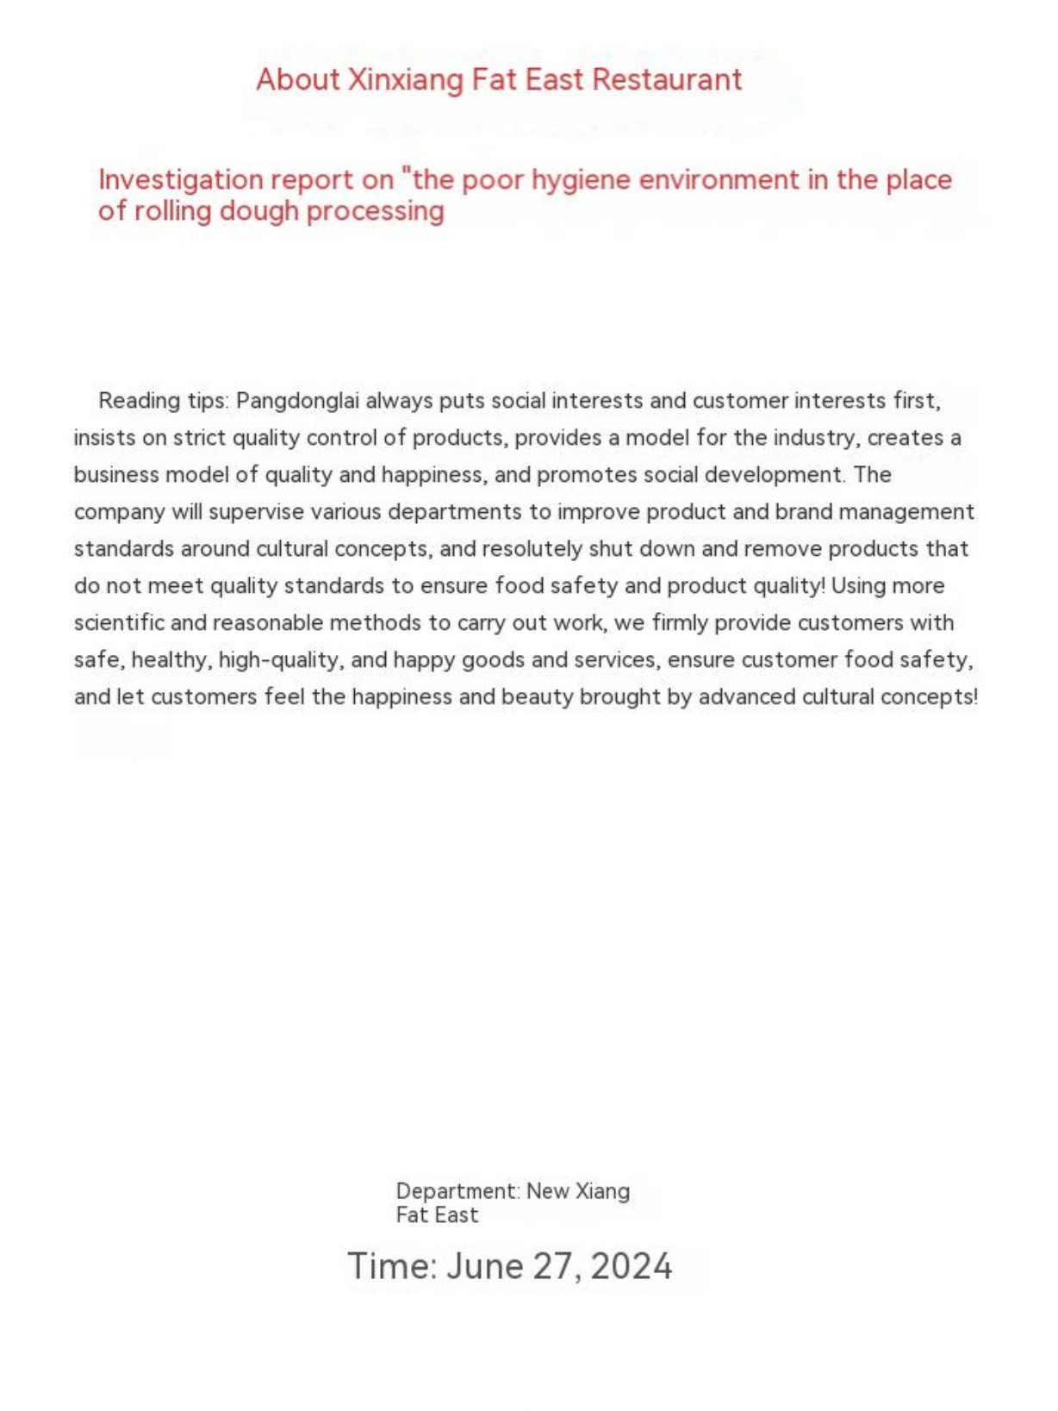
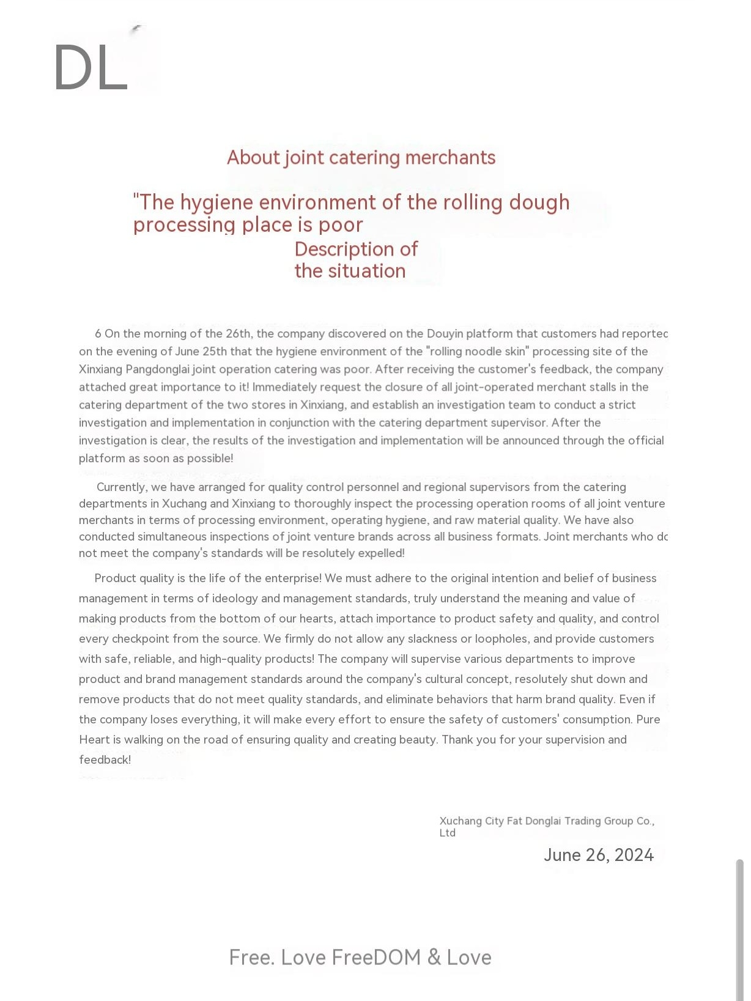
PART 2
Steps Taken by the Company
Investigation report on " the poor sanitary environment of the noodle processing site" of Xinxiang PDL Catering business
Explanation of " the poor sanitary environment of the noodle processing site" of the affiliated catering business

Slide 7
PART 3
Role of Public Relations
Rebuilding trust with customers
Quick response and compensation mechanism
Transparent communication
Clarify the company's position and actions
Strict accountability and institutional rectification
Strengthening the regulatory system

Slide 8
PART 3
Role of Public Relations
Limit brand reputation damage
Reward whistleblowers
Proactively assuming long-term responsibility

Slide 9
PART 4
Outcome
Success points
Rapid crisis response
Effective public opinion guidance
Lessons to be improved
Vulnerabilities in supply chain supervision
Lessons to be improved
Employee responsibility
boundary
Short term reputation damage, long-term trust enhancement
Industry benchmark effect

Slide 10
THANK YOU
Group numbers：Jocelyn, Rin, Cecilia, Judy

